Slide 1
Lectures on Informatics: An Introduction to Computers and Informatics in the Health Sciences
Sequencing Application III:
Visualization of Microbiome Data
Christopher Taylor
Associate Professor
Department of Microbiology,
Immunology & Parasitology

Slide 2
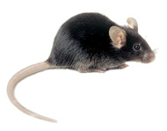
Analysis of Microbiome Data
Using Behavioral Mouse data set
Chow, HFD, Donors
Primary Data Analysis
Merging, Filtering, Dereplication, OTU Clustering, Chimera Removal, Representative Set Picking, Phylogenetic Tree Building, Taxonomic Assignment
Outputs: OTU Table, Phylogenetic Tree
Secondary Data Analysis
Alpha diversity, Beta Diversity, Taxonomic Summary

Slide 3
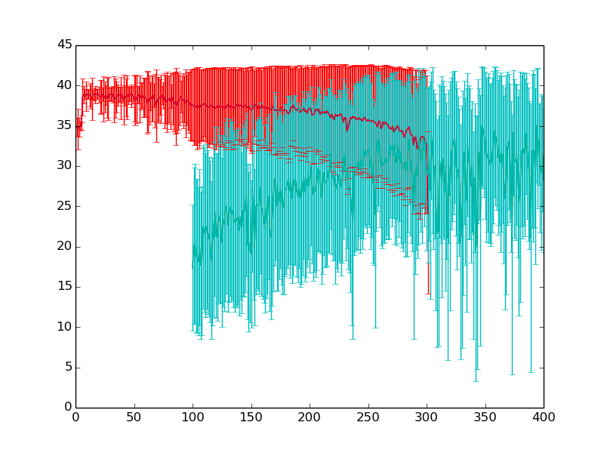
Merging Forward & Reverse Reads
Q-Score
Amplicon Position (bp)

Slide 4
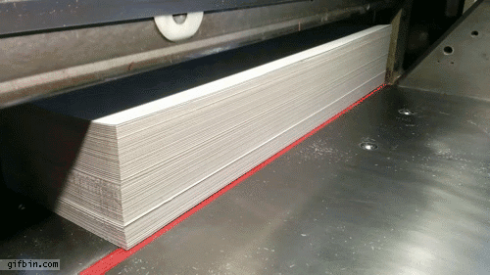
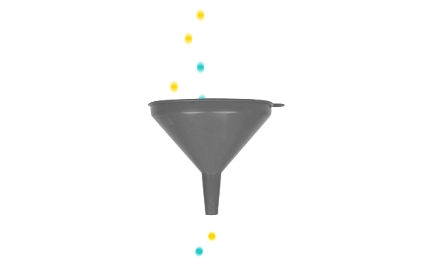
Filtering Merged Reads
Truncate each read to 400 bp long
Filter out any reads which have a base pair with Q-Score < 5 in the 400 bp merged read
Removes any reads with N base calls (Q-Score 2)
Removes any reads with P_{error} > 0.4
This leaves us with reasonable quality merged amplicon reads
All Q-Scores >= 5 (Most Q-Scores >>> 5)

Slide 5
Concatenate and Dereplicate
Now we have one read file for each sample
It contains merged forward and reversed reads
Filtered to moderate quality amplicon reads
Concatenate reads from all samples into a single read file
Dereplicate the concatenated sequence file
Remove all but one copy of each identical read
Maintain a count in the header of duplicates

Slide 6
Remove Singletons
In the dereplicated sequence file, remove every read which only appeared once across all samples
That is, the exact 400 nt sequence was only seen once in one sample, never seen again
Very highly likely to have been a sequencing error
Even a very rare bacterial sequence would have very likely been seen in more than one sample or seen more than one time within a sample

Slide 7
Cluster OTUs
OTU – Operational Taxonomic Unit
Rule of thumb → Bacterial species separation is about 97% sequence identity
Why use Why use OTUs?
OTUs are used as a computational efficiency

Slide 8
Analysis Workflow
Quality Filtering
Millions of Reads
Still Millions of Reads
Chimera Detection
Sequence Alignment
Make Phylogenetic Tree
Takes a long time!
Taxonomic Assignment
Hundreds of Species
Still Millions of Reads

Slide 9
Operational Taxonomic Units (OTUs)
Quality Filtering
Millions of Reads
Still Millions of Reads
Clustering into OTUs
Chimera Detection
Sequence Alignment
Make Phylogenetic Tree
Hundreds of OTUs
Hundreds of OTUs
Taxonomic Assignment
Hundreds of Species

Slide 10
OTU Picking Spectrum
Still an active area of research
Dereplication (Obvious)
Tradeoff:
100% Identity Clusters (No OTUs Approach)
No loss of resolution, but very compute intensive
97% Identity Clusters (OTUs <= 3% Difference)
Potential loss of resolution, less compute intensive
UPARSE is a novel approach that attempts to achieve the best of both sides of the spectrum

Slide 11
Improved Data Analysis Pipeline
Nat Methods. 2013 Oct;10(10):996-8. doi: 10.1038/nmeth.2604.
UPARSE: highly accurate OTU sequences from microbial amplicon reads.
Edgar RC.
Independent Investigator, Tiburon, California, USA.
Abstract
Amplified marker-gene sequences can be used to understand microbial community structure, but they suffer from a high level of sequencing and amplification artifacts. The UPARSE pipeline reports operational taxonomic unit (OTU) sequences with ≤1% incorrect bases in artificial microbial community tests, compared with >3% incorrect bases commonly reported by other methods. The improved accuracy results in far fewer OTUs, consistently closer to the expected number of species in a community.
PMID: 23955772 [PubMed - in process]

Slide 12
Chimeric OTU removal
During PCR amplification of 16S rDNA, chimeric PCR products can occur
Depending on the PCR cycle when a chimera forms, it can become quite abundant
It will look like a new species of bacteria
There are several approaches to find chimeras
de novo
Gold Standard database

Slide 13
Global Search of Original Sequences
The original merged filtered sequences are searched against the OTU clusters we formed
The non-chimeric OTU clusters
This allows us to determine how many times each OTU we have identified appeared in each original sample
Produces an OTU table/matrix with samples in the columns and OTUs in the rows
Entry indicates how many reads mapped to that OTU from that sample

Slide 14
Pick Representative Set
A representative read is chosen from each OTU cluster
This representative sequence will be used to represent the entire OTU cluster
The set of representative sequences are aligned and a phylogenetic tree is built to relate OTUs to one another based on phylogenetic distance of their representative sequence
The representative sequence of each OTU is searched against RDP to assign a taxonomic classification to each OTU

Slide 15
Primary Analysis Script
Developed a script to encapsulate the UPARSE analysis steps
$ uparse_primary.py -i MouseRaw/ -o MousePrimary/ --merge_truncqual 2 --filter_truncqual 5 --filter_trunclen 400
merge_truncqual should be set to 2 for illumina
filter_truncqual 5 or 10 depending on quality
filter_trunclen set to smallest amplicon size

Slide 16
Output of Primary Analysis
OTU Table in BIOM format
The OTU table is a matrix where each column represents a sample from the analysis
Each row represents an OTU
Each OTU has a taxonomic classification assigned to it
An entry in the matrix counts the # of times the given OTU appeared in the given sample
Phylogenetic Tree
The leaves of the phylogenetic tree are the OTUs
Distance between two OTUs gives a measure of their evolutionary distance for comparisons that we will make between the communities (Beta Diversity)

