Slide 1
Lectures on Informatics: An Introduction to Computers and Informatics in the Health Sciences
Sequencing Application IV:
Discussion of Metagenomic Methods
Christopher Taylor
Associate Professor
Department of Microbiology,
Immunology & Parasitology

Slide 2
Secondary Data Analysis
Input:
OTU Table (in BIOM format)
Phylogenetic Tree
Metadata Mapping File
Contains the Sample Names in the first column
Each subsequent column contains a metadata category
The entry in that column classifies each sample in that category
Example for mouse experiment on next slide

Slide 3
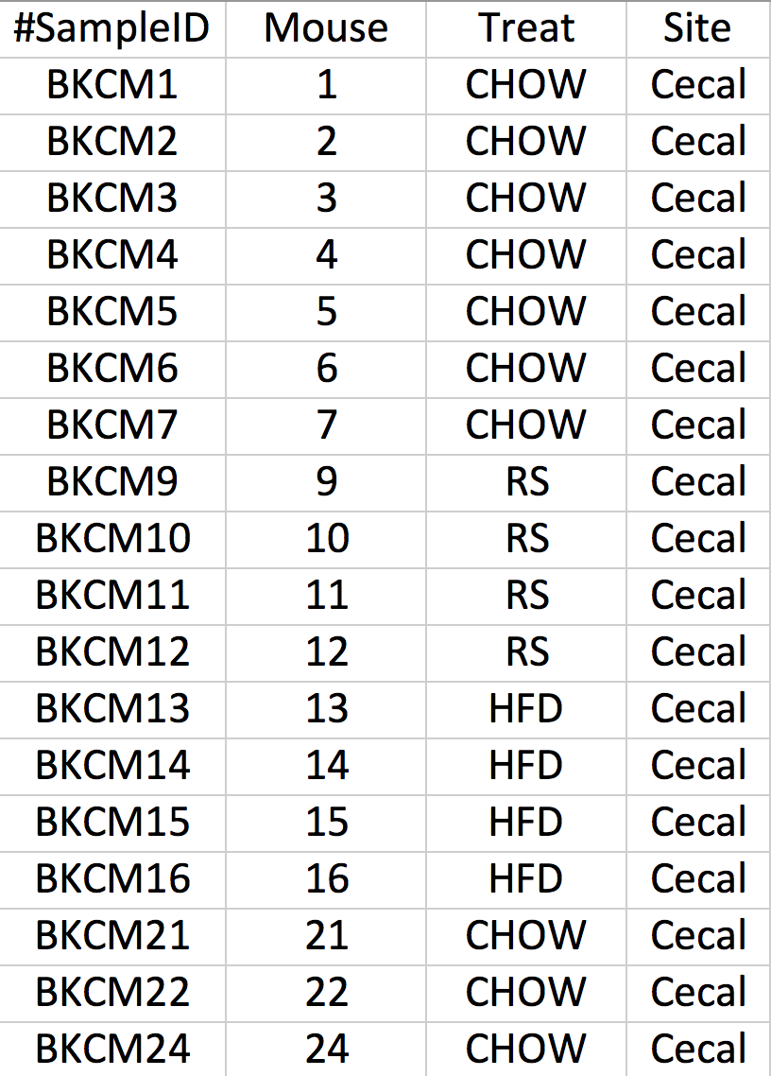
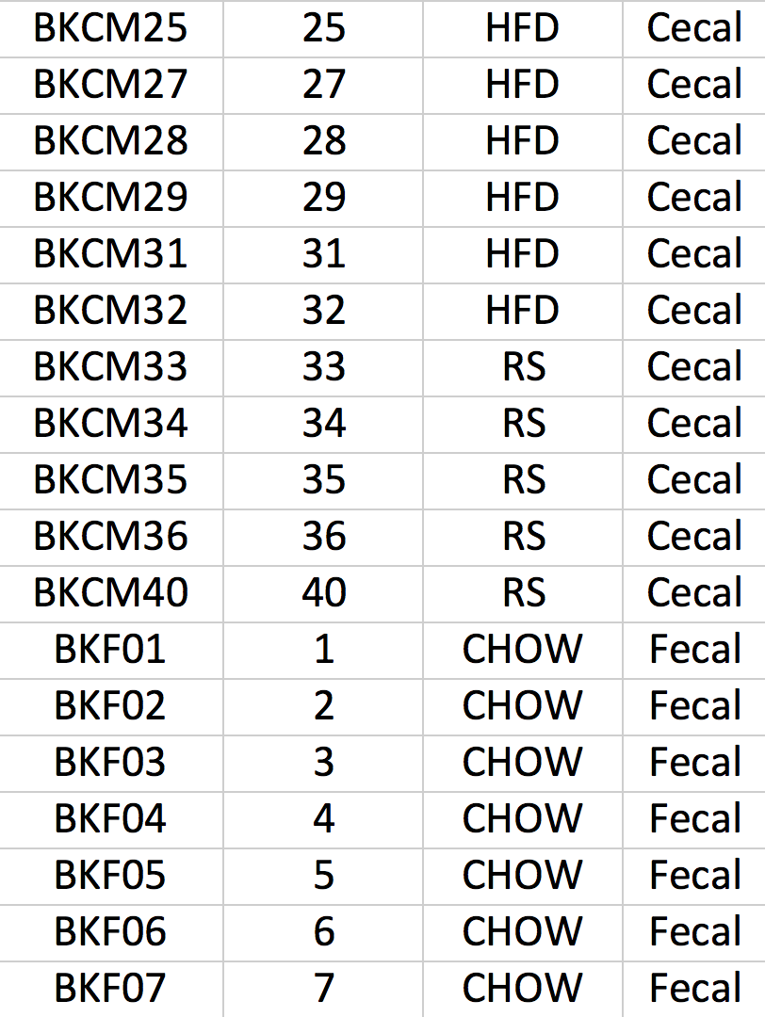
Metadata Mapping File
etc

Slide 4
Rarefaction Level
In any microbiome sequencing experiment, there are several samples that get sequenced
We aim for uniform read depth in each sample
In reality, samples get sequenced at different depths
In order to fairly compare the microbial communities across these samples, a rarefaction level is chosen and a random sample of reads is taken from each sample
This is called the rarefaction level and is chosen based on the distribution of read counts in each sample

Slide 5
Read Counts for Mouse Example
Counts/sample detail:
BKF32: 4462.0
BKF28: 4949.0
BKF06: 6255.0
BKCM7: 6277.0
BKF31: 6458.0
BKCM4: 6782.0
BKF16: 6910.0
BKCM32: 7071.0
BKF22: 7182.0
BKF14: 7286.0
BKF40: 8024.0
BKCM21: 8320.0
BKCM36: 9018.0
BKF24: 9767.0
BKF29: 10274.0
BKCM34: 10450.0
BKF03: 10772.0
BKF25: 11012.0
BKF27: 11299.0
BKCM6: 11735.0
BKF07: 11886.0
BKCM13: 12157.0
BKF05: 12344.0
BKF13: 12535.0
BKCM2: 12859.0
BKCM27: 12975.0
BKCM5: 13690.0
BKCM3: 13974.0
BKCM1: 14319.0
BKF01: 14516.0
BKF11: 15203.0
BKF12: 15435.0
BKCM33: 15449.0
BKF04: 15757.0
BKF02: 15793.0
BKF33: 16217.0
BKF35: 16229.0
BKF10: 16316.0
BKF09: 16746.0
BKCM35: 17682.0
BKCHOW: 18035.0
BKCM15: 18416.0
BKCM25: 18600.0
BKCM40: 18649.0
BKF34: 19125.0
BKCM29: 20654.0
BKF15: 21545.0
BKCM12: 22723.0
BKCM24: 23306.0
BKCM28: 23398.0
BKCM22: 23512.0
BKCM31: 24010.0
BKF21: 24480.0
BKCM11: 24779.0
BKF36: 25882.0
BKCM9: 26423.0
BKCM14: 27759.0
BKHFD: 30053.0
BKRS: 31469.0
BKCM16: 33512.0
BKCM10: 42233.0
Rarefaction Level:
4100

Slide 6
Secondary Analysis Script
Developed a script to encapsulate the secondary analysis steps
$ secondary_analysis.py -b otus.biom -m mappingfile.txt -p parameters.txt -t tree.tre
This script organizes directory structure, moves files, runs each analysis subscript and provides graphical visualizations of analysis results

Slide 7
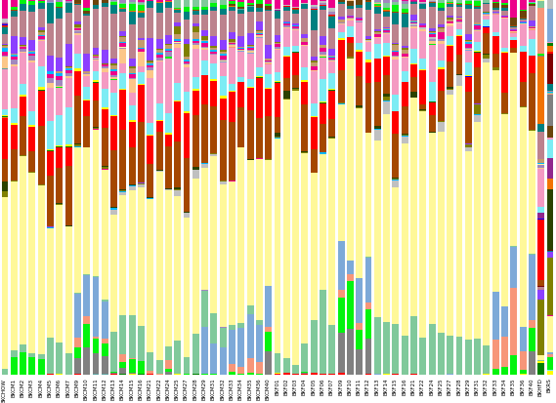
Individual Taxonomic Summary

Slide 8
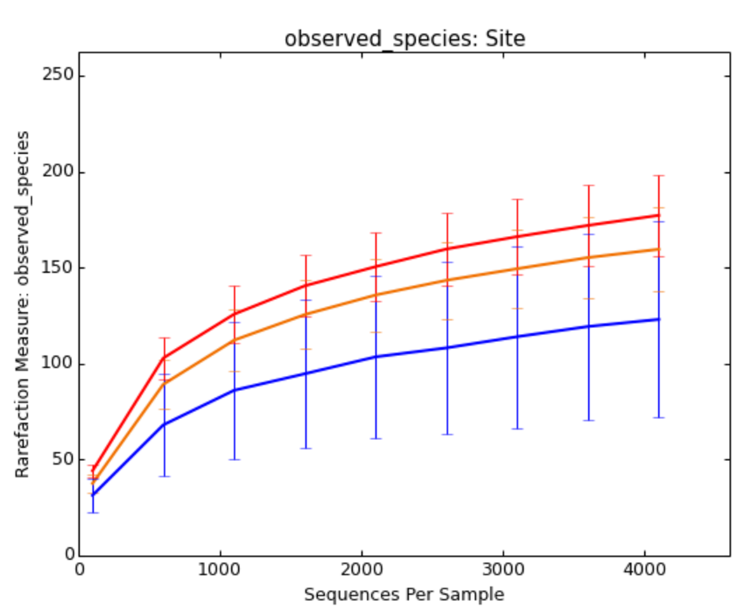
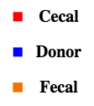
Alpha Diversity Rarefaction Plot

Slide 9
Beta Diversity (Unweighted UniFrac)
High Fat Donor Pool
High Fat Recipients
RS Donor Pool
RS Recipients
Chow Donor Pool
Chow Recipients

Slide 10
Metagenomic Methods
To this point, we have been discussing 16S rRNA amplification to take census of bacteria present in a community
This single gene is amplified and searched against a database to determine which bacteria are present and in what relative quantities
Full metagenomic sequencing would entail sequencing all of the DNA found in an environment instead of amplifying 16S rRNA

Slide 11
Full Metagenomic Sequencing
A much larger sequencing effort is required for full metagenomic sequencing
With 16S rRNA the sequencing breadth is restricted to one ~ 200-500 bp amplicon
Selectively amplified with Universal primers
This restricted breadth allows for sufficient depth to be achieved with relatively little sequencing
Full metagenomic sequencing does not restrict the breadth of sequencing
Instead you are sequencing all of the DNA present

Slide 12
Full Metagenomic Sequencing (cont)
Advantages of this method are that you survey the genetic potential of an environment
That is, you find out what genes are present
It is very difficult and computationally challenging to assemble metagenomes
DNA that is sequenced comes from a variety of organisms
It is easy to accidentally misassemble parts of one bacteria with another

Slide 13
Metatranscriptomic Sequencing
Metatranscriptomics is the meta corollary to transcriptomic sequencing
RNA-Seq on a community
This assays the gene expression of a community whereas metagenomics looks at the genetic potential of a community
Both Metagenomics and Metatranscriptomics are expensive requiring a lot of sequencing

Slide 14
PICRUSt
Phylogenetic Investigation of Communities by Recostruction of Unobserved States (PICRUSt)
This approach uses 16S rDNA sequencing data along with databases of metagenomic information about bacteria to infer the metagenomics of an environment
16S tells you who is there
Metagenomic database tells you what they typically do

Slide 15
PICRUSt (cont)
PICRUSt is essentially a cheap alternative to full metegenomic sequencing
Authors show that inferred metagenomics of communities very accurately estimates actual metagenomic sequencing done on the same communities
Obviously, the target environments must be well characterized in advance
Unstudied environments with a variety of unknown bacteria would not do well with PICRUSt

Slide 16
Evaluation
Shortly, you will be receiving a request via the google groups forum to complete a survey
Please give your feedback through this survey
It will help me to restructure and reorganize this material in the future for an official course
Join the forum if you haven’t done so already:
https://groups.google.com/forum/#!forum/lecturesoninformatics

