Slide 1
Lectures on Informatics: An Introduction to Microbial Community Sequencing and Analysis
Lecture #10:
Processing Microbiome Data: Secondary Data Analysis with QIIME (Part 3)

Slide 2
Category Taxa Summary
Produce Taxa Summary grouped by “Receive” category
> summarize_taxa_through_plots.py -i otus.01.biom -m mappingfile.txt -p params.txt -o taxa_summary/taxa_Receive -c Receive -s
Produce Taxa Summary grouped by “Sample” category
> summarize_taxa_through_plots.py -i otus.01.biom -m mappingfile.txt -p params.txt -o taxa_summary/taxa_Sample –c Sample -s
Produce Taxa Summary grouped by “Mouse” category
> summarize_taxa_through_plots.py -i otus.01.biom -m mappingfile.txt -p params.txt -o taxa_summary/taxa_Mouse –c Mouse -s

Slide 3
Alpha Diversity
Alpha diversity measures within sample diversity
The easiest metric to understand is observed species
Counts the number of species (or nodes) per sample
The rarefaction plots are used to evaluate how alpha diversity grows with increasing sequencing effort
Have we sequenced samples deeply enough?
We aim to see that the rarefaction curves “plateau” by the time we reach our sequencing depth
If they don’t, we may not have sequenced deeply enough to adequately capture the sample diversity

Slide 4
Alpha Diversity
Recall our params relating to alpha diversity and rarefaction
> multiple_rarefactions:min 100
We will start with a subsampling depth of 100
> multiple_rarefactions:step 1000
We will step in increments of 1000 reads
> multiple_rarefactions:max 5100
We will stop at a maximum depth of 5100 reads per sample
> alpha_diversity:metrics shannon,simpson,PD_whole_tree,chao1,observed_species
We will measure each of the listed metrics

Slide 5
Alpha Rarefaction
> alpha_rarefaction.py -i otus.biom -m mappingfile.txt -p params.txt -t tree.tre -a –O 42 -o alpha_diversity
This code produces the alpha rarefaction plots
Let’s take a look at them

Slide 6
Beta Diversity
Beta diversity (β-diversity) is a measure between samples
This is a pairwise comparison which produces a distance between each pair of samples in a study
Alpha diversity (α-diversity) was a measure within a sample
Richness vs Evenness
Sample A
Sample B
Sample C

Slide 7
UniFrac Analysis
Measures difference between two environments as branch length unique to one environment or the other on the phylogenetic tree of 16S sequences (remember our tree.tre)
Two very different environments would have sequences segregate into their own branches
Most of the branch length would be unique to one environment or the other producing a UniFrac value near 1
Two very similar environments would have sequences intermingled throughout the tree
They may have many of the same sequences
Less branch length would be unique

Slide 8
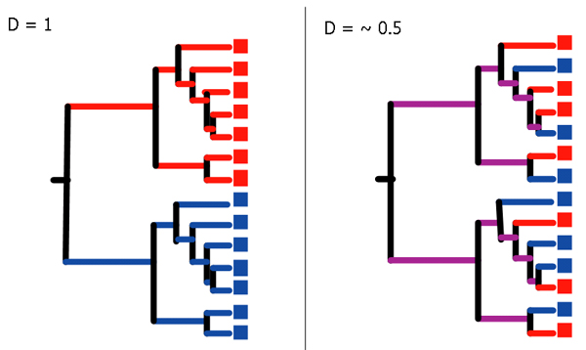
UniFrac Analysis
Identical environments would produce a UniFrac value D=0 because every leaf of the tree would have a representative from both environments

Slide 9
UniFrac Significance Test
Question: Are differences between the environments significant?
The UniFrac value of the actual tree (A) is calculated
Environment labels are permuted and another UniFrac value is calculated D₁ (same tree structure kept, sample assignments shuffled)
This is repeated N times to calculate permuted UniFrac values D₁–D_{N}
P-Value is fraction of permuted trees that have UniFrac values >= A
If this fraction is high (near 1) then the actual environments are more similar than expected at random
If this fraction is low (near 0) then the actual environments are more different than expected at random
A P-value near 0 is significant evidence that the environments being compared are very different from one another

Slide 10
Beta Diversity
Beta diversity metrics are computed and plots of those metrics are produced with this code:
> beta_diversity_through_plots.py -i otus.biom -m mappingfile.txt -t tree.tre -o beta_diversity
> make_2d_plots.py -i beta_diversity/unweighted_unifrac_pc.txt -m mappingfile.txt -o beta_diversity/2d_unweighted_unifrac_plots
> make_2d_plots.py -i beta_diversity/weighted_unifrac_pc.txt -m mappingfile.txt -o beta_diversity/2d_weighted_unifrac_plots
Let’s look at these plots

