Slide 1
Lectures on Informatics: An Introduction to Microbial Community Sequencing and Analysis
Lecture #6:
Processing Microbiome Data: Primary Data Analysis with DADA2 (Part 1)

Slide 2
Moving away from OTUs
UPARSE Primary Analysis (Lecture 5) is an Operational Taxonomic Unit (OTU) based approach
This is a computational efficiency that was introduced over a decade ago to process millions of sequences
It had the added benefit of obscuring errors from data
But also obscured important sub-species differences
Our Oligotyping approach (Lecture 3) helped discern important differences from sequencing errors
Similar approaches have been developed recently

Slide 3
DADA2 Data Analysis Pipeline
Nat Methods. 2016 Jul;13(7):581-3. doi: 10.1038/nmeth.3869.
DADA2: High-resolution sample inference from illumina amplicon data.
Callahan BJ, McMurdie PJ, Rosen MJ, Han AW, Johnson AJ, Holmes SP.
Department of Statistics, Stanford University, Stanford, California, USA.
Abstract
We present the open-source software package DADA2 for modeling and correcting Illumina-sequenced amplicon errors (https://github.com/benjjneb/dada2). DADA2 infers sample sequences exactly and resolves differences of as little as 1 nucleotide. In several mock communities, DADA2 identified more real variants and output fewer spurious sequences than other methods. We applied DADA2 to vaginal samples from a cohort of pregnant women, revealing a diversity of previously undetected Lactobacillus crispatus variants.
PMID: 27214047

Slide 4
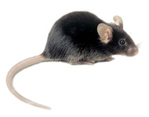
Primary Analysis with DADA2
Using Behavioral Mouse data set
There was a third group
Standard Chow (CHOW)
Chow Donor Pool (CHOWD)
High Fat Diet (HFD)
HFD Donor Pool (HFDD)
Resistant Starch (RS)
RS Donor Pool (RSD)
Donors were Rats not Mice

Slide 5
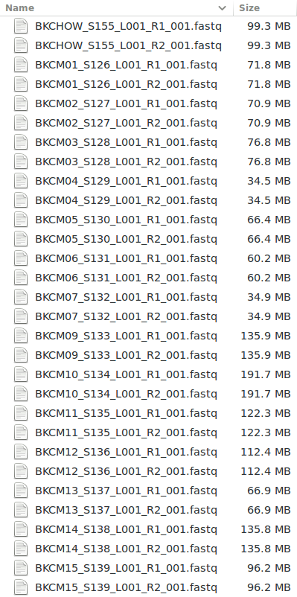
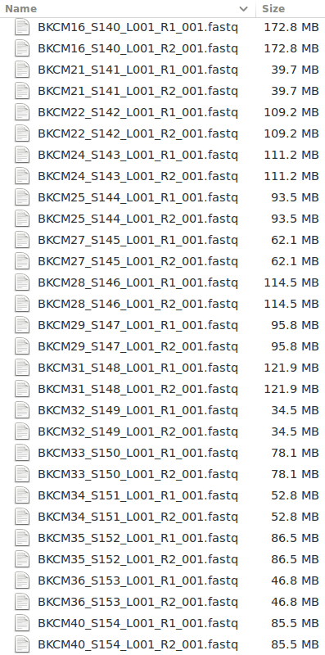
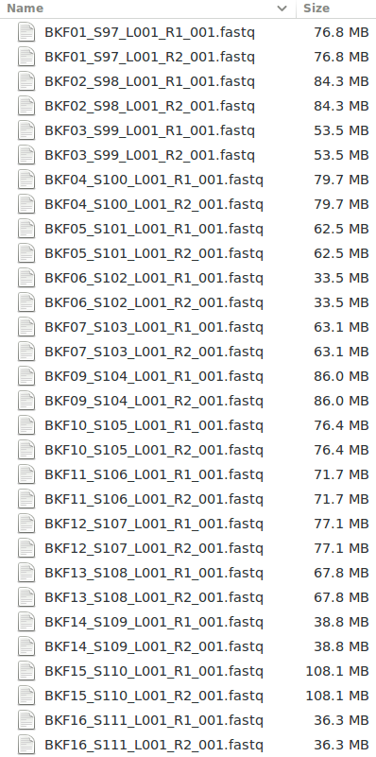
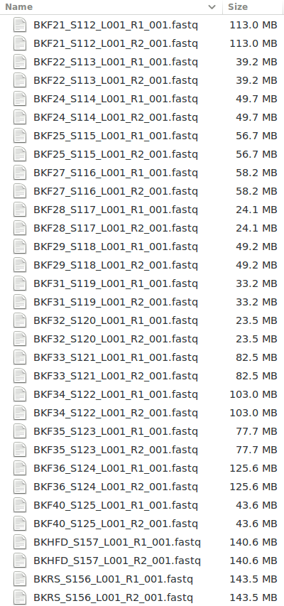
Forward and Reverse Read Files
61 Total Samples (122 Total Files)
20 CHOW, 20 HFD, 18 RS, 1 CHOWD, 1 HFDD, 1 RSD

Slide 6
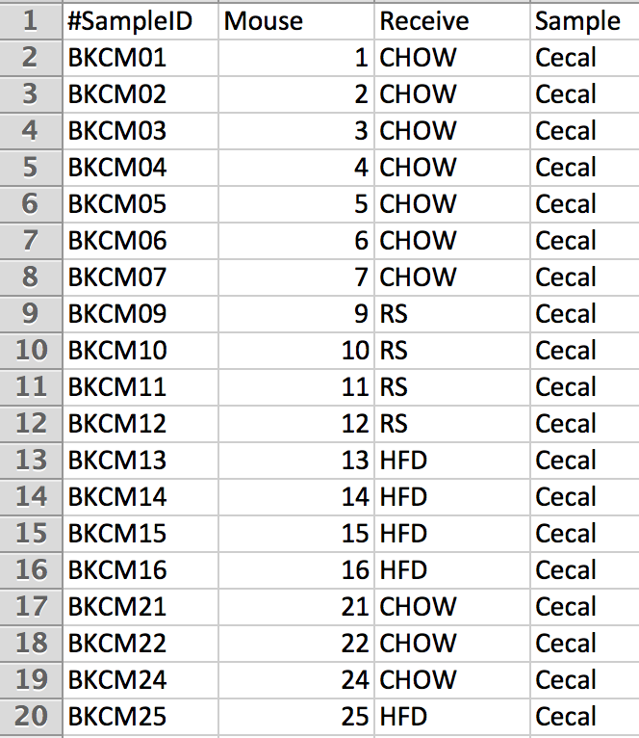
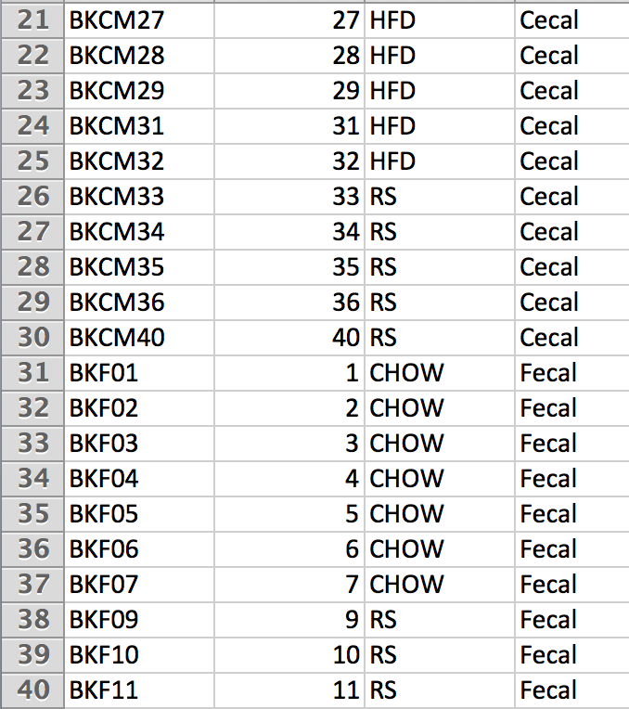
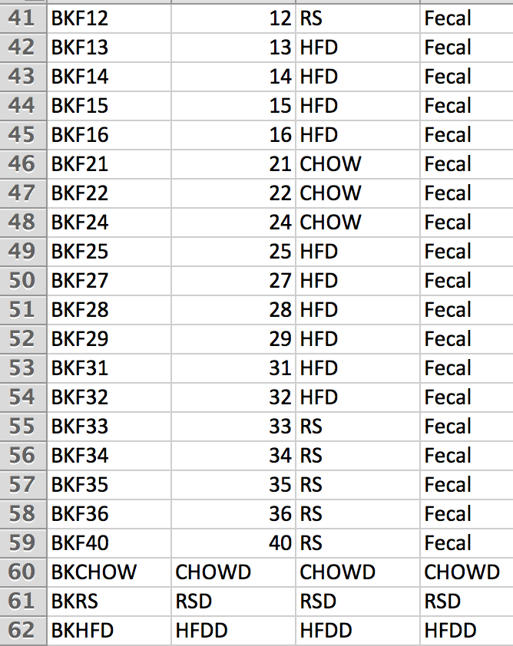
Mapping Information
61 Total Samples
20 CHOW, 20 HFD, 18 RS, 1 CHOWD, 1 HFDD, 1 RSD

Slide 7
Filtering and Trimming
The first two steps of DADA2 are to filter and trim your reads
In order to choose the appropriate parameters for these operations, it is important to view your data quality and we can create quality plots for each of the fastq files to visualize

Slide 8
Load R Packages
/home/chris/Documents/ABKdada/Primary $ R
R version 3.3.2 (2016-10-31) -- "Sincere Pumpkin Patch"
Copyright (C) 2016 The R Foundation for Statistical
Computing Platform: x86_64-pc-linux-gnu (64-bit)
> .cran_packages <- c("colorout", "ggplot2", "gridExtra", "foreach", "doParallel", "iterators", "parallel")
> .bioc_packages <- c("dada2", "msa", "phyloseq")
> sapply(c(.cran_packages, .bioc_packages), require, character.only = TRUE)

Slide 9
Setup Paths and Directories
> cl<-makeCluster(42, outfile="dada2.log")
> registerDoParallel(cl)
> set.seed(1333)
> path = "/home/chris/Documents/ABKdada/Primary"
> raw = file.path(path, "raw”)
> filtpath <- file.path(path, "filtered")
> dir.create(filtpath)
> fns <- list.files(raw)
> fnFs <- fns[grepl("_R1_001.fastq", fns)] # Just the forward read files
> fnRs <- fns[grepl("_R2_001.fastq", fns)] # Just the reverse read files

Slide 10
Create Quality Profiles
> sample.names <- sapply(strsplit(fnFs, "_"), `[`, 1)
> plotpath <- file.path(path, "raw_quality_plots/")
> dir.create(plotpath)
> foreach(d=fnFs, i=icount(), .packages='dada2') %dopar% {
+ ffile <- paste0(plotpath,basename(fnFs[i]),".png")
+ png(filename=ffile, width= 1000, height= 1000, res= 200)
+ print(plotQualityProfile(file.path(raw, fnFs[[i]])))
+ dev.off()
+ rfile <- paste0(plotpath,basename(fnRs[i]),".png")
+ png(filename=rfile, width= 1000, height= 1000, res= 200)
+ print(plotQualityProfile(file.path(raw, fnRs[[i]])))
+ dev.off()
+ }

Slide 11
Examine Quality Profiles
A quality plot is now available as a .png file for each raw forward and reverse fastq file
This provides an overview of the quality scores per sequencing cycle within each sample
As always, the quality tends to start off high and to fall over the length of the read
It tends to drop off faster on the reverse reads than for the forward reads
The goal of viewing these plots is to determine good parameters for filtering and trimming the reads

Slide 12
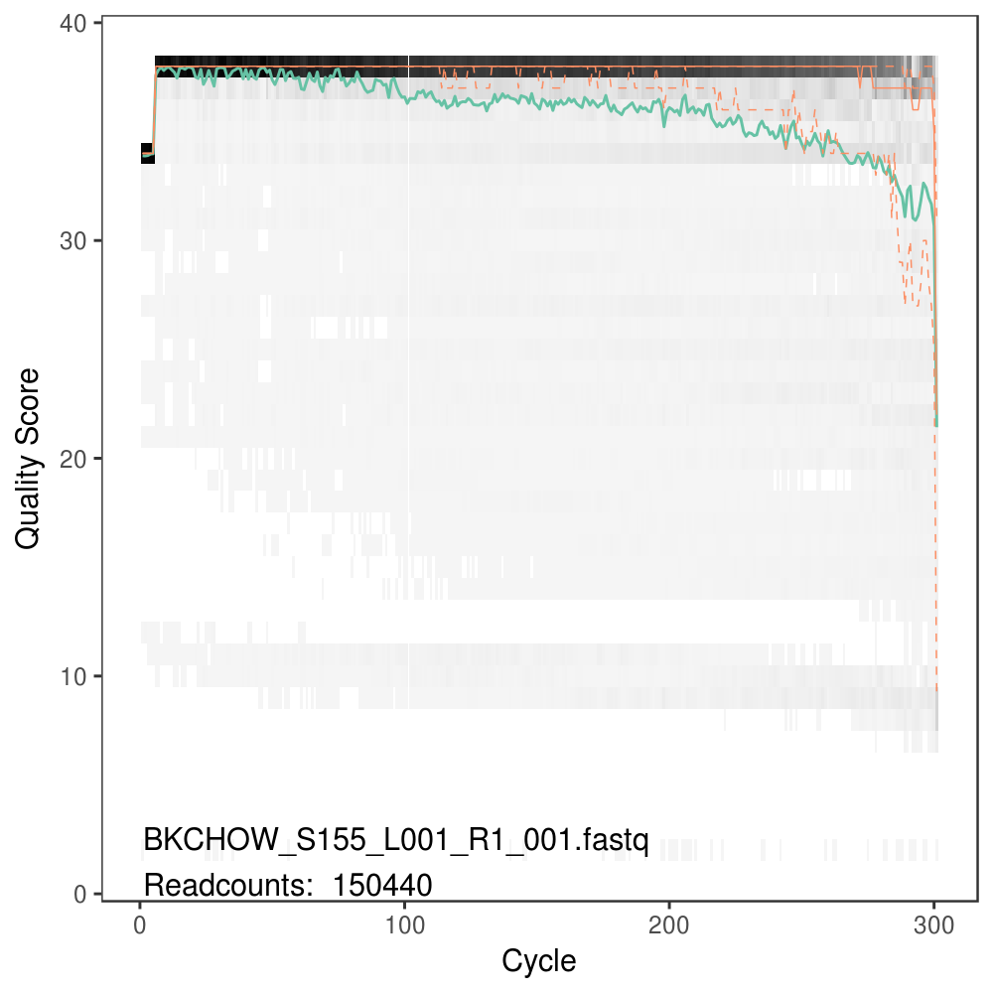
Forward Read Quality
Always trim off the first 10 bp
About 280 bp into the forward read quality drops off significantly

Slide 13
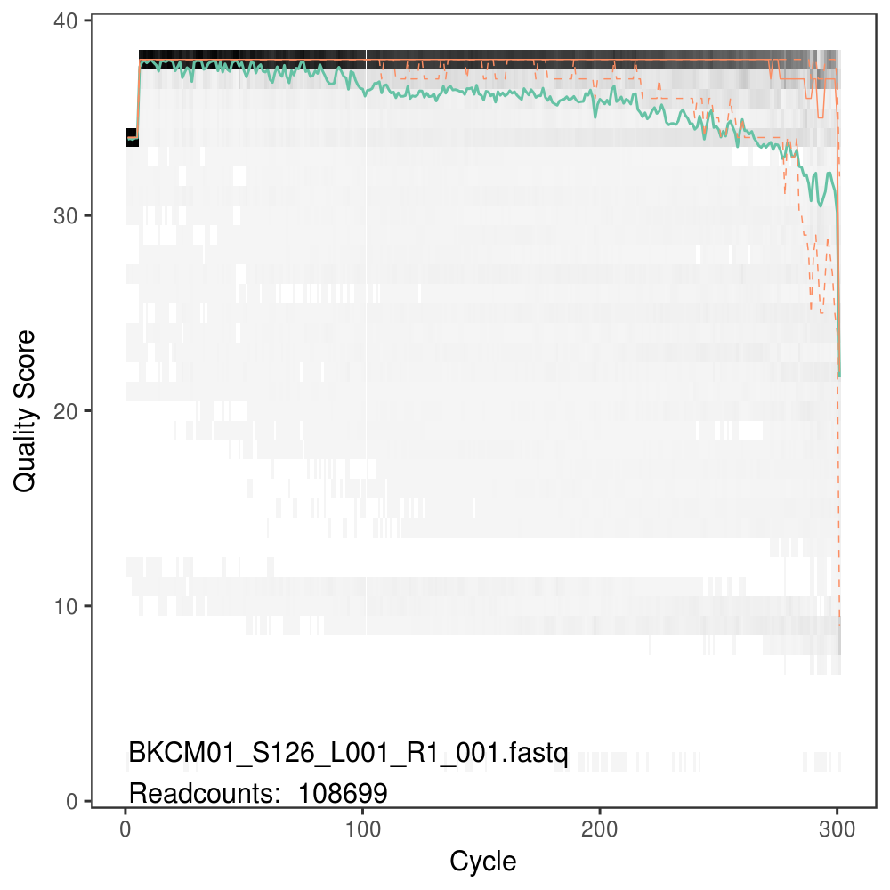
Forward Read Quality
Always trim off the first 10 bp
About 280 bp into the forward read quality drops off significantly

Slide 14
GIF of all Forward Reads
> system("convert -loop 0 -layers optimize raw_quality_plots/*_R1_001.fastq.png raw_quality_plots/quailty_R1.gif")

Slide 15
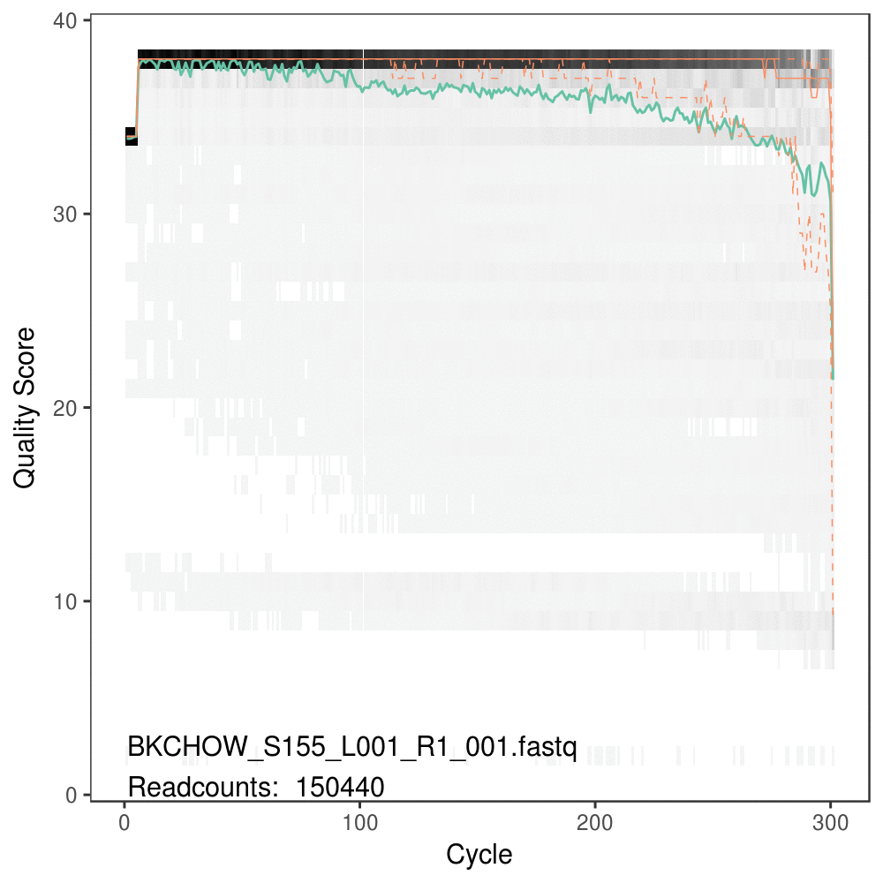
All Forward Reads
Always trim off the first 10 bp
About 280 bp into the forward read quality drops off significantly

Slide 16
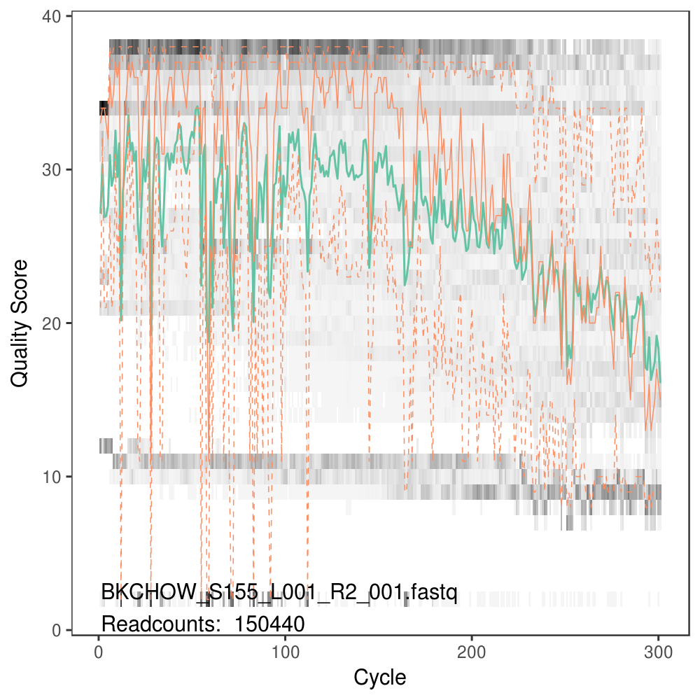
Reverse Read Quality
Always trim off the first 10 bp
Reverse qualities are much worse
About 200 bp into the reverse read quality drops < 25

Slide 17
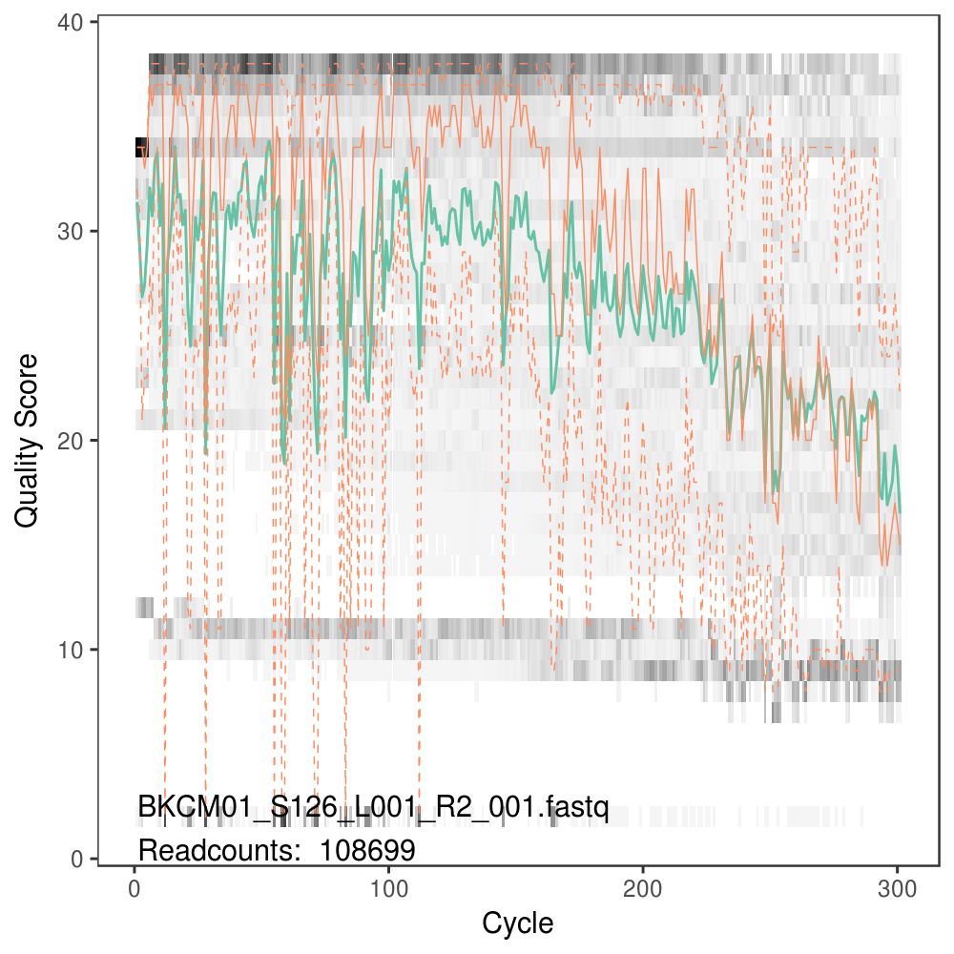
Reverse Read Quality
Always trim off the first 10 bp
Reverse qualities are much worse
About 200 bp into the reverse read quality drops < 25

Slide 18
GIF of all Reverse Reads
> system("convert -loop 0 -layers optimize raw_quality_plots/*_R2_001.fastq.png raw_quality_plots/quailty_R2.gif")

Slide 19
All Reverse Reads
Always trim off the first 10 bp
Reverse qualities are much worse
About 200 bp into the reverse read quality drops < 25

