Slide 1
Lectures on Informatics: An Introduction to Microbial Community Sequencing and Analysis
Lecture #9:
Processing Microbiome Data: Secondary Data Analysis with QIIME (Part 2)

Slide 2
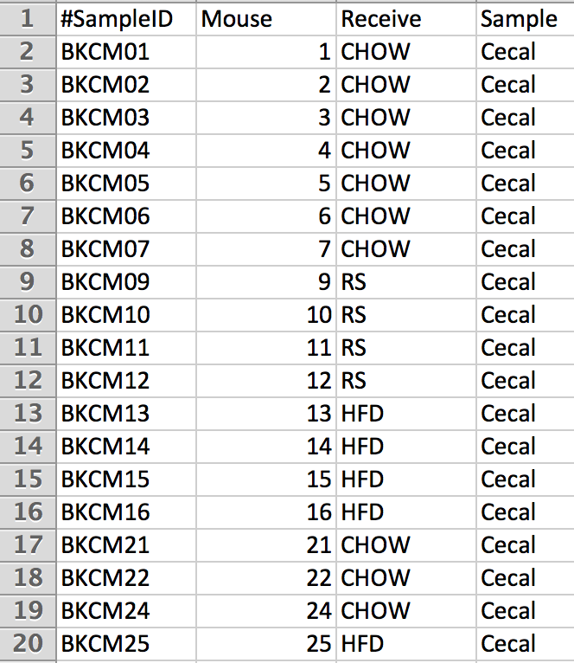
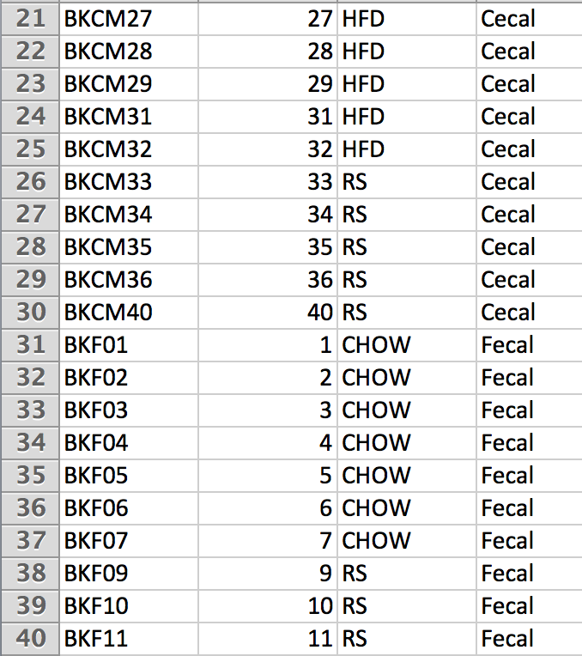
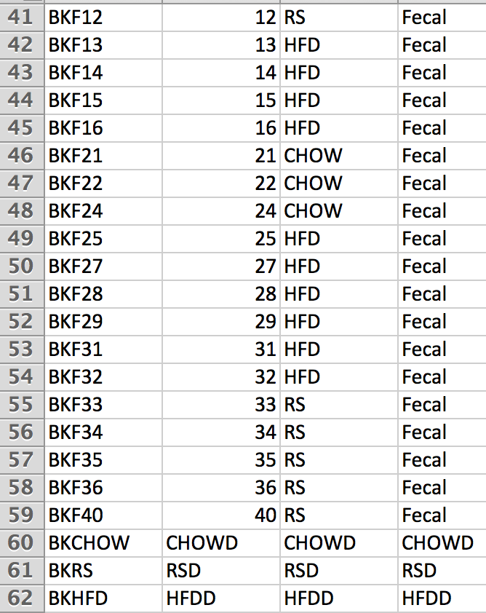
Mapping Information
61 Total Samples
20 CHOW, 20 HFD, 18 RS, 1 CHOWD, 1 HFDD, 1 RSD

Slide 3
Summarize Biom Table
> biom summarize-table –i otus.biom –o table_summary
Num samples: 61
Num observations: 803
Total count: 1145975
Table density (fraction of non-zero values): 0.165
Counts/sample summary:
Min: 5180.0
Max: 51789.0
Median: 17372.000
Mean: 18786.475
Std. dev.: 9384.608
Sample Metadata Categories: None provided
Observation Metadata Categories: taxonomy; confidence; method

Slide 4
Summarize Biom Table
Counts/sample detail:
BKF32: 5180.0
BKF28: 5840.0
BKCM04: 7093.0
BKCM07: 7170.0
BKF31: 7282.0
BKF22: 7920.0
BKF16: 8157.0
BKF06: 8289.0
BKCM32: 8666.0
BKF14: 8973.0
BKCM21: 9199.0
BKF40: 9341.0
BKCM36: 10613.0
BKF24: 10936.0
BKF29: 11837.0
BKF03: 12186.0
BKCM34: 12633.0
BKF25: 12920.0
BKF27: 13345.0
BKCM06: 13955.0
BKCM13: 14238.0
BKF13: 14565.0
BKF07: 14611.0
BKCM02: 14656.0
BKCM03: 15545.0
BKCM05: 15658.0
BKF05: 15674.0
BKCM01: 15824.0
BKCM27: 16337.0
BKF01: 16502.0
BKF04: 17372.0
BKF11: 17754.0
BKF02: 17861.0
BKF12: 18101.0
BKCM33: 18327.0
BKF10: 18673.0
BKF09: 19123.0
BKF33: 19476.0
BKF35: 19519.0
BKF34: 21032.0
BKCM15: 21407.0
BKCHOW: 21577.0
BKCM40: 21805.0
BKCM35: 22188.0
BKCM25: 22663.0
BKF15: 25085.0
BKCM24: 25625.0
BKCM12: 25647.0
BKCM22: 26280.0
BKCM29: 26633.0
BKCM31: 27575.0
BKF21: 28347.0
BKCM28: 28512.0
BKF36: 29231.0
BKCM09: 29637.0
BKCM11: 30852.0
BKCM14: 32746.0
BKHFD: 36383.0
BKCM16: 39225.0
BKRS: 40385.0
BKCM10: 51789.0

Slide 5
Parameters file
Now we can fill in the parameters file for QIIME:
> summarize_taxa:level 1,2,3,4,5,6,7,8
> plot_taxa_summary:labels Kingdom,Phylum,Class,Order,Family,Genus,Species,Node
> alpha_diversity:metrics shannon,simpson,PD_whole_tree,chao1,observed_species
> multiple_rarefactions:min
> multiple_rarefactions:max
> multiple_rarefactions:step
> beta_diversity:metrics bray_curtis,unweighted_unifrac,weighted_unifrac
> beta_diversity_through_plots:seqs_per_sample
100
5100
1000
4000

Slide 6
secondary_analysis.py
We developed a python script to automate the steps of secondary analysis:
> secondary_analysis.py –b otus.biom –m mappingfile.txt –p params.txt –t tree.tre
This script generates a shell script to arrange folders and execute commands for secondary analysis

Slide 7
Taxonomic Summaries
First we filter sequence variants from the OTU table that appear at total less than 1%:
> filter_otus_from_otu_table.py -i otus.biom -o otus.01.biom --min_count_fraction 0.001
Next we produce a taxonomic summary for each sample
> summarize_taxa_through_plots.py -s -i otus.01.biom -m mappingfile.txt -p params.txt -o taxa_summary/taxa_individual
Let’s view the individual taxonomic summary

Slide 8
Category Taxa Summary
Produce Taxa Summary grouped by “Receive” category
> summarize_taxa_through_plots.py -i otus.01.biom -m mappingfile.txt -p params.txt -o taxa_summary/taxa_Receive -c Receive -s
Produce Taxa Summary grouped by “Sample” category
> summarize_taxa_through_plots.py -i otus.01.biom -m mappingfile.txt -p params.txt -o taxa_summary/taxa_Sample –c Sample -s
Produce Taxa Summary grouped by “Mouse” category
> summarize_taxa_through_plots.py -i otus.01.biom -m mappingfile.txt -p params.txt -o taxa_summary/taxa_Mouse –c Mouse -s

